Slide 1
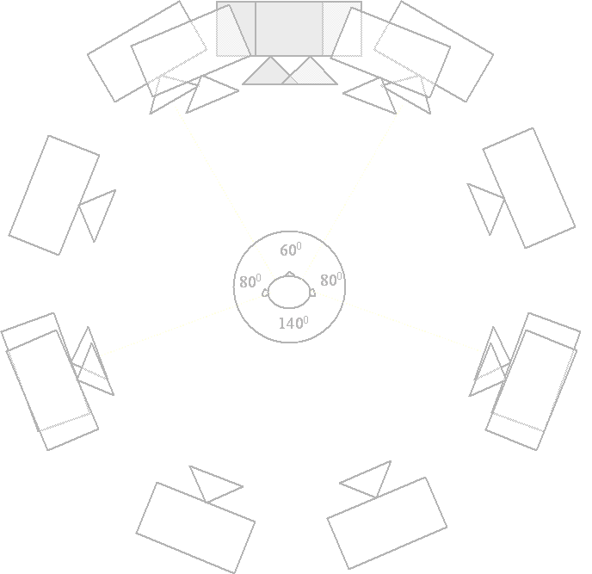
Ambisonics Part 1
Speaker Agnostic Surround Sound
Dr Bruce Wiggins
b.j.wiggins@derby.ac.uk

Slide 2
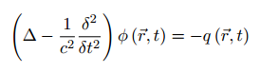
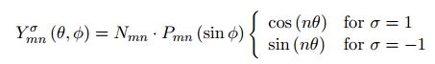
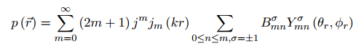
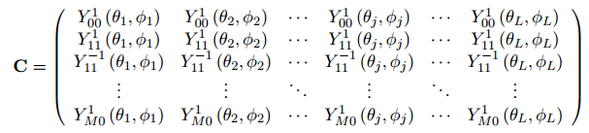
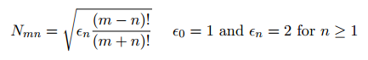
How to explain Ambisonics?
Ambisonic encoding is based on Spherical Harmonic Decomposition of a sound field…

Slide 3
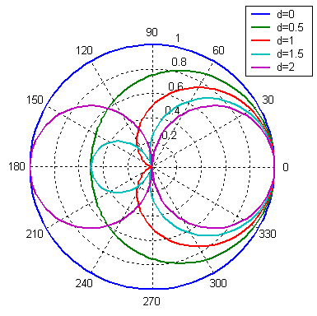
Combining Microphone Patterns
It’s possible to create any microphone pattern between an omni-directional and a figure of 8, by x-fading between the two…
Omni
r(θ) = 1
Figure of 8
r(θ) = cos(θ)
Mixing equation
r(θ) = 0.5 x ((2-d).omni + (d x f8))

Slide 4
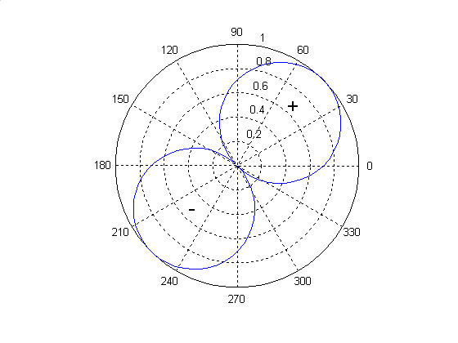
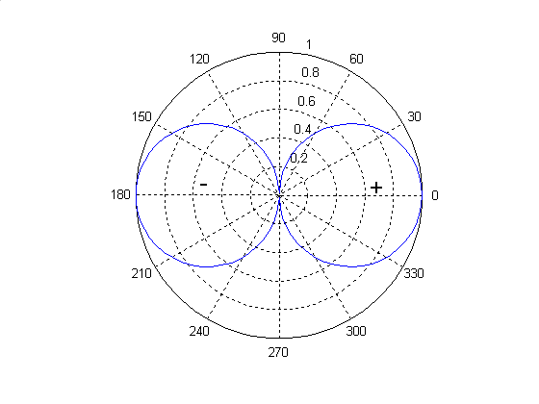
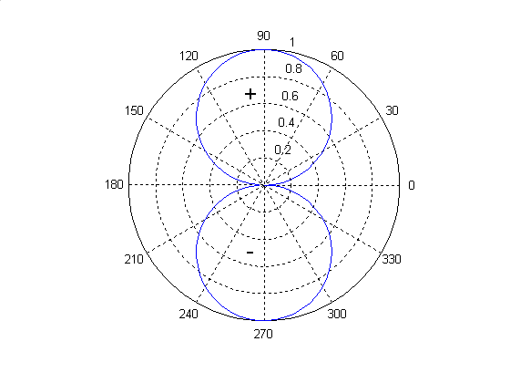
Combining Figure of Eights
Adding together two perpendicular figure of eight microphones will result in a figure of eight microphone positioned between them:
+
=

Slide 5
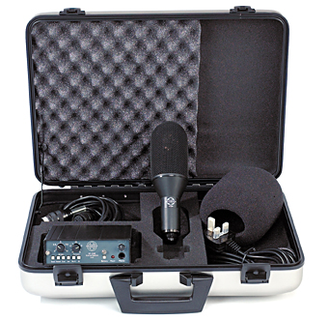
The SoundField Microphone
The SoundField microphone uses the two principles discussed above:
Omni + Figure of 8
Adding Two figure of 8’s
in order to produce any first order polar response in any direction using just one microphone.
Picture of a SoundField ST250
http://www.dv247.com/microphones/soundfield-st250--21012

Slide 6
The SoundField Microphone
First the three figure of 8 microphones are summed to produce a figure of eight pointing in any direction.
Then this is mixed with the omni-directional mic to produce a variable mic pattern in this direction.

Slide 7
How do we choose some mics?
Given a mic system where we can generate mic signals that are:
Pointing in any direction we want
Using whatever polar pattern we wish…
…how do we decide what we use for:

Slide 8
What is ‘Ambisonics’?
What is Ambisonics?
It is isotropic (uniformity in all orientations) – it makes no assumptions of front dominance etc.
A system where the spatial encoding of the audio is separate from the decoding of that audio to a set of speakers.
A set of rules and equations that help to optimise and quantify the performance of a multi-speaker audio presentation.
A system based on coincident recording principles.
An extendable system based on Spherical Harmonics (mic patterns!).
A future proof audio format.

Slide 9
Why should you want it?
Can be successfully decoded to many different speaker arrays:
Mono
Mono compatibility is still important!
Just use W, omni feed!
Stereo
UHJ allows for stereo compatible downmix
Preserves level balance between sources…
…and gives a predictable spatial representation
Hard panning (only amplitude) is avoided, making headphone listening more natural

Slide 10
Why should you want it?
Decode to standard surround sound arrays (we want people to hear this stuff!):
4.0
5.1
7.1
x.x
Decode to larger, arbitrary speaker arrays
Better for large events (use more speakers, rather than bigger speakers!)

Slide 11
Decoding - Projection
S = 0.5 x [((2-d) x 1.414 x W) + (d x ((cos(θ).X) + (sin(θ).Y)))]
where S = speaker feed
d = directional constant (0 -> 2)
θ = Angular direction of speaker (virtual mic output)
W, X & Y = B-format input channels

Slide 12
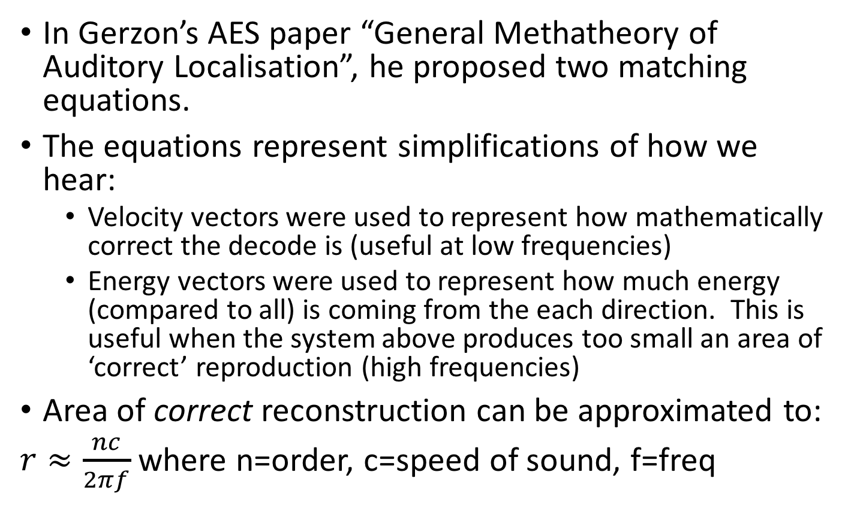
How Do We Choose a Virtual Mic?
In Gerzon’s AES paper “General Methatheory of Auditory Localisation”, he proposed two matching equations.
The equations represent simplifications of how we hear:
Velocity vectors were used to represent how mathematically correct the decode is (useful at low frequencies)
Energy vectors were used to represent how much energy (compared to all) is coming from the each direction. This is useful when the system above produces too small an area of ‘correct’ reproduction (high frequencies)
Area of correct reconstruction can be approximated to:
$r≈\frac{nc}{2πf}$ where n=order, c=speed of sound, f=freq

Slide 13
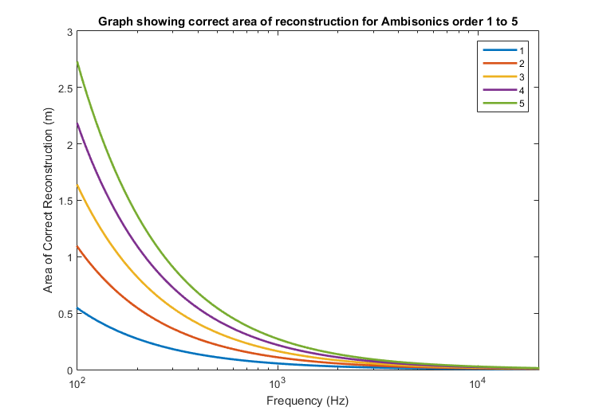
Correct Reconstruction

Slide 14
Vector Analysis
If a source is simulated moving all around the listener, the resulting decode can be analysed.
Velocity Vector
Low Frequency
Energy Vector
High Frequency
Where:
g_{i} represents the gain of a speaker (assumed real for simplicity).
n is the number of speakers.
θ_{i} is the angular position of the i^{th} speaker.

Slide 15
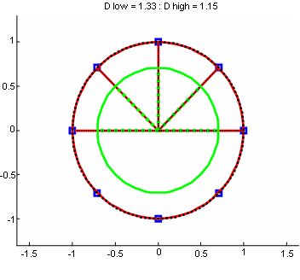
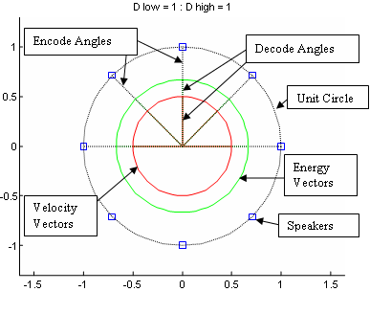
1st Order Decoders

Slide 16
Higher Order Ambisonics
Uses more input signals…
…which can result in better control of the speaker feeds and, hence, reproduced sound field.
0th Order
1st Order
2nd

Slide 17
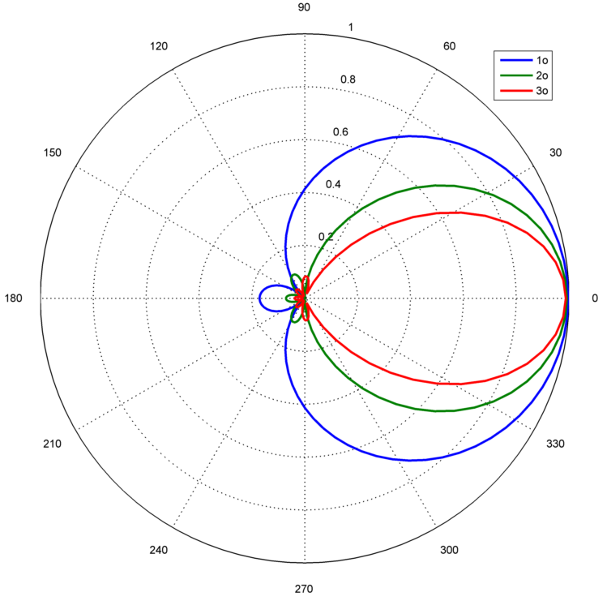
Polar Pattern Choice

Slide 18
Decoding – Psuedo Inverse
As we’ve already mentioned, Ambisonic is based on Spherical Harmonic Decomposition.
Compare to time->frequency domain
How much of each frequency is contained within the time domain signal
Spherical Harmonic Decomposition:
How much of each spatial degree and order (a bit like direction) is present in the sound field (Gerzon called this a ‘direction cosine’)

Slide 19
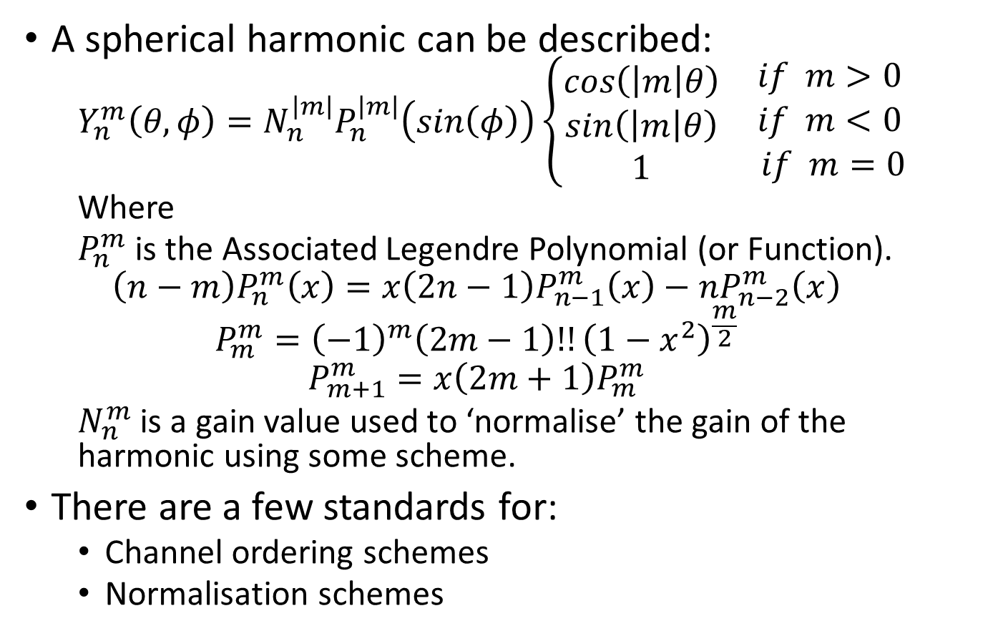
Spherical Harmonics
A spherical harmonic can be described:
$$Y_{n}^{m}\left(θ,φ\right)={N_{n}^{\left|m\right|}P}_{n}^{\left|m\right|}\left(sin\left(φ\right)\right)\left\{\begin{matrix}cos\left(\left|m\right|θ\right) \\ \begin{aligned}sin\left(\left|m\right|θ\right) \\ 1\end{aligned}\end{matrix}\right. \begin{matrix}if m>0 \\ \begin{aligned}if m<0 \\ if m=0\end{aligned}\end{matrix}$$
Where
$P_{n}^{m}$ is the Associated Legendre Polynomial (or Function).
$$\left(n−m\right)P_{n}^{m}\left(x\right)=x\left(2n−1\right)P_{n−1}^{m}\left(x\right)−nP_{n−2}^{m}\left(x\right)$$
$$P_{m}^{m}={\left(−1\right)}^{m}\left(2m−1\right)!!{\left(1−x^{2}\right)}^{\frac{m}{2}}$$
$$P_{m+1}^{m}=x\left(2m+1\right)P_{m}^{m}$$
$N_{n}^{m}$ is a gain value used to ‘normalise’ the gain of the harmonic using some scheme.
There are a few standards for:
Channel ordering schemes
Normalisation schemes

Slide 20
Associated Legendre Polynomials
From Green03

Slide 21
Furse-Malham Set
Label | Order | Angle/Elevation Representation | Cartesian Representation
W | 0 | sqrt(1/2) | sqrt(1/2)
X | 1 | cos(A)cos(E) | x
Y | 1 | sin(A)cos(E) | y
Z | 1 | sin(E) | z
R | 2 | (1/2)(3sin(E)sin(E)-1) | (1/2)(3zz-1)
S | 2 | cos(A)sin(2E) | 2zx
T | 2 | sin(A)sin(2E) | 2yz
U | 2 | cos(2A)cos(E)cos(E) | xx-yy
V | 2 | sin(2A)cos(E)cos(E) | 2xy
K | 3 | (1/2)sin(E)(5sin(E)sin(E)-3) | (1/2)z(5zz-3)
L | 3 | sqrt(135/256)cos(A)cos(E)(5sin(E)sin(E)-1) | sqrt(135/256)x(5zz-1)
M | 3 | sqrt(135/256)sin(A)cos(E)(5sin(E)sin(E)-1) | sqrt(135/256)y(5zz-1)
N | 3 | sqrt(27/4)cos(2A)sin(E)cos(E)cos(E) | sqrt(27/4)z(xx-yy)
O | 3 | sqrt(27/4)sin(2A)sin(E)cos(E)cos(E) | sqrt(27)xyz
P | 3 | cos(3A)cos(E)cos(E)cos(E) | x(xx-3yy)
Q | 3 | sin(3A)cos(E)cos(E)cos(E) | y(3xx-yy)

Slide 22
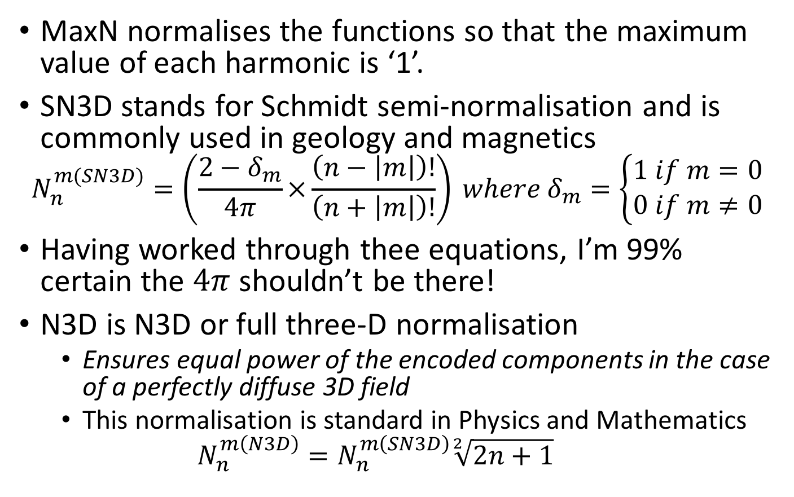
Normalisation Schemes
MaxN normalises the functions so that the maximum value of each harmonic is ‘1’.
SN3D stands for Schmidt semi-normalisation and is commonly used in geology and magnetics
$$N_{n}^{m(SN3D)}=\left(\frac{2−δ_{m}}{4π}×\frac{\left(n−\left|m\right|\right)!}{\left(n+\left|m\right|\right)!}\right) where δ_{m}=\left\{\begin{aligned}1 if m=0 \\ 0 if m≠0\end{aligned}\right.$$
Having worked through thee equations, I’m 99% certain the $4π$ shouldn’t be there!
N3D is N3D or full three-D normalisation
Ensures equal power of the encoded components in the case of a perfectly diffuse 3D field
This normalisation is standard in Physics and Mathematics
$$N_{n}^{m\left(N3D\right)}=N_{n}^{m\left(SN3D\right)}\sqrt[2]{2n+1}$$

Slide 23
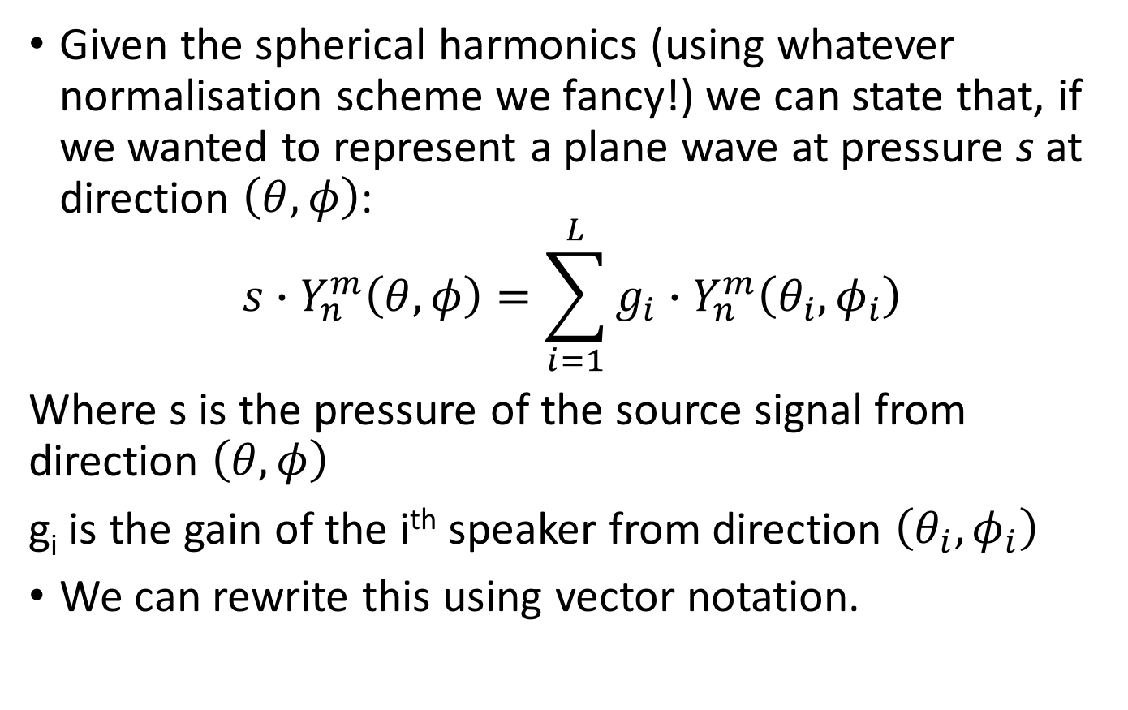
Spherical Decomposition
Given the spherical harmonics (using whatever normalisation scheme we fancy!) we can state that, if we wanted to represent a plane wave at pressure s at direction $\left(θ,φ\right)$:
$${s∙Y}_{n}^{m}\left(θ,φ\right)=\sum_{i=1}^{L}{g_{i}}∙Y_{n}^{m}\left(θ_{i},φ_{i}\right)$$
Where s is the pressure of the source signal from direction $\left(θ,φ\right)$
g_{i} is the gain of the i^{th} speaker from direction $\left(θ_{i},φ_{i}\right)$
We can rewrite this using vector notation.

Slide 24
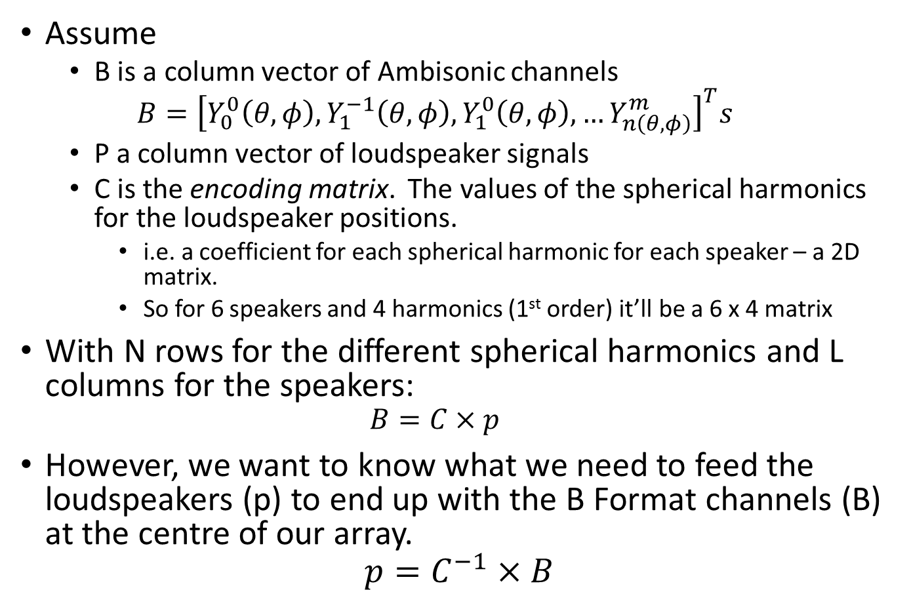
Decoding Matrix
Assume
B is a column vector of Ambisonic channels
$$B={\left[Y_{0}^{0}\left(θ,φ\right),Y_{1}^{−1}\left(θ,φ\right),Y_{1}^{0}\left(θ,φ\right),…Y_{n\left(θ,φ\right)}^{m}\right]}^{T}s$$
P a column vector of loudspeaker signals
C is the encoding matrix. The values of the spherical harmonics for the loudspeaker positions.
i.e. a coefficient for each spherical harmonic for each speaker – a 2D matrix.
So for 6 speakers and 4 harmonics (1st order) it’ll be a 6 x 4 matrix
With N rows for the different spherical harmonics and L columns for the speakers:
$$B=C×p$$
However, we want to know what we need to feed the loudspeakers (p) to end up with the B Format channels (B) at the centre of our array.
$$p=C^{−1}×B$$

Slide 25


Invert a Matrix
For example, take a four speaker square array
This would be fed by only the horizontal 1st order Spherical Harmonics
B = [W X Y]^{T}
Speaker angles are:
45,135,-45,-135
C is the encoding matrix.
Generate the position of the speakers by the weightings of the spherical harmonics.

Slide 26
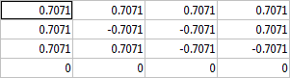
Invert a Matrix
For example, take a four speaker square array
Front Left Speaker
+45 degrees
W = 0.707 = 0.707
X = cos(45)cos(0) = 0.707
Y = sin(45)cos(0) = 0.707
Z = sin(0) = 0
Repeat for each speaker, end up with 3x4 matrix, or a 4x4 matrix if we use Z

Slide 27
Invert a Matrix
Now, to generate the coefficients we’d need to weight the W, X, Y & Z channels that are fed to each speaker so they’d sum to give us our original, we invert the Matrix.
You’ll remember
We can only invert a square matrix
We can only invert if the determinant is not 0
From the last slide, our matrix is:
Either not square (we might not have four speakers, or if we discount Z)
It is square, but the determinant, in this case is 0
In this (and every case!) we must find some other way.

Slide 28
Psuedo Inverse
To solve this problem we can use the Moore-Penrose Matrix Inverse.
Given an m x n matrix C, the MPP Inv will give a unique n x m matrix C⁺
Pinv(C) = C^{T}(C x C^{T})⁻¹
C multiplied by it’s transpose will generate a square matrix which can then be inverted.
Then the transpose is multiplied by this matrix, essentially cancelling it’s effect.
Clever, eh!

Slide 29
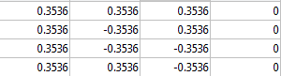
Pinv C
So, in Matlab, the pseudo inverse of C is written as:
pinv(C)
Which, in this case, will give us the result:
W
X
Y
Z
FL
BL
BR
FR
This is our decoding matrix ☺

Slide 30
Polar Pattern
What does the polar pattern of the resulting virtual microphone look like? (note I’m using blue for in-phase, red for out-of-phase)
The virtual mic is pointing at the speaker
With a polar pattern of around 1.33

Slide 31
How about a rectangle decode?
Speakers at +/- 30 degrees and +/- 150?

Slide 32
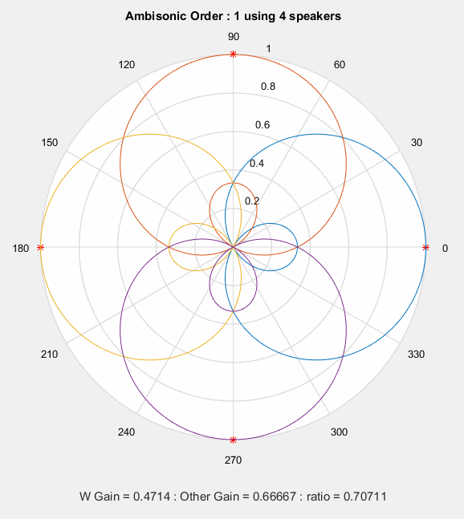
Higher Orders

Slide 33
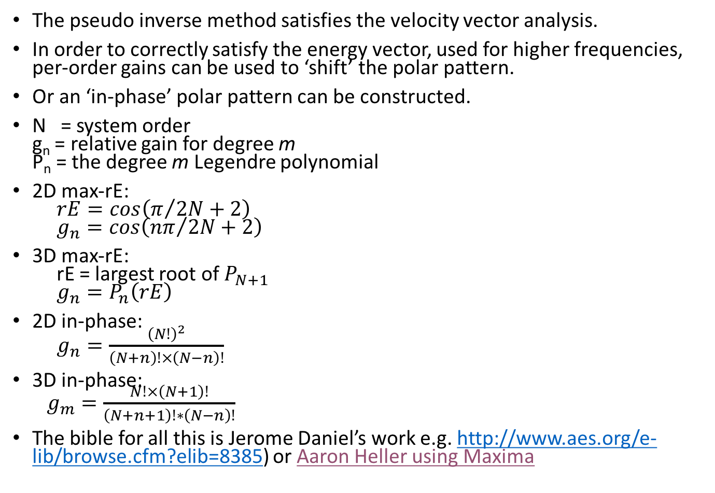
Psycho-acoustic Optimisation
The pseudo inverse method satisfies the velocity vector analysis.
In order to correctly satisfy the energy vector, used for higher frequencies, per-order gains can be used to ‘shift’ the polar pattern.
Or an ‘in-phase’ polar pattern can be constructed.
N = system order g_{n} = relative gain for degree m P_{n} = the degree m Legendre polynomial
2D max-rE: $rE=cos\left(π/{2N+2}\right)$ $g_{n}=cos\left({nπ}/{2N+2}\right)$
3D max-rE: rE = largest root of $P_{N+1}$ $g_{n}=P_{n}\left(rE\right)$
2D in-phase: $g_{n}=\frac{{\left(N!\right)}^{2}}{\left(N+n\right)!×\left(N−n\right)!}$
3D in-phase: $g_{m}=\frac{N!×\left(N+1\right)!}{\left(N+n+1\right)!∗\left(N−n\right)!}$
The bible for all this is Jerome Daniel’s work e.g. http://www.aes.org/e-lib/browse.cfm?elib=8385) or Aaron Heller using Maxima

Slide 34
Psycho-acoustic Optimisation
rE 2D | 0 1 2 3 4
------------------------------------------------
1 | 1 0.707
2 | 1 0.866 0.500
3 | 1 0.924 0.707 0.383
4 | 1 0.951 0.809 0.588 0.309
rE 3D | 0 1 2 3 4
------------------------------------------------
1 | 1 0.577
2 | 1 0.775 0.400
3 | 1 0.862 0.612 0.305
4 | 1 0.906 0.732 0.501 0.246

Slide 35
In-phase
IP 2D | 0 1 2 3 4 ------------------------------------------------ 1 | 1 0.500 2 | 1 0.667 0.167 3 | 1 0.750 0.300 0.050 4 | 1 0.800 0.400 0.114 0.014 IP 3D | 0 1 2 3 4 ------------------------------------------------ 1 | 1 0.333 2 | 1 0.500 0.100 3 | 1 0.600 0.200 0.029 4 | 1 0.667 0.286 0.071 0.008

Slide 36
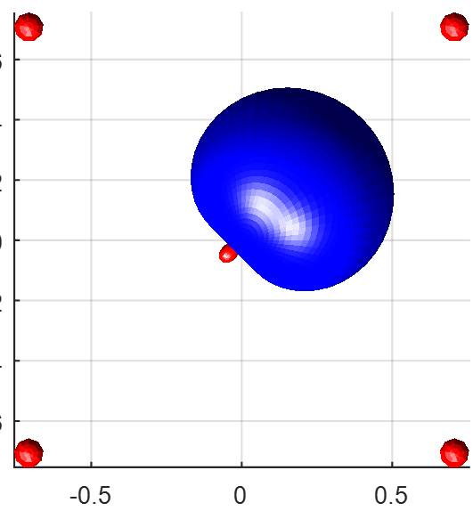
End Result – 4 speaker Quad
LF
HF →

Slide 37
Visualisations
Web
Windows
Mac
Ambisonic Signals
Ambisonic Signals
Ambisonic Signals
1st, 2nd & 3rd Order
Regular Decode
1st, 2nd & 3rd Order
Regular Decode
1st, 2nd & 3rd Order
Regular Decode
Why not 3rd Order
All the time???
Why not 3rd Order
All the time???
Why not 3rd Order
All the time???
3rd Order
Irregular Decode
3rd Order
Irregular Decode
3rd Order
Irregular Decode

Slide 38
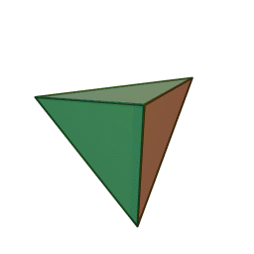
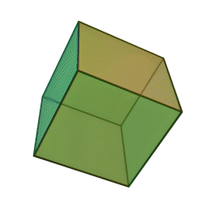
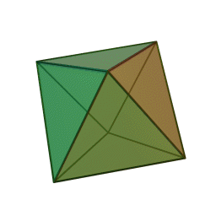
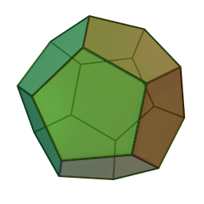
Decoder Design
We need enough speakers to be able to reproduce the spherical harmonics to reproduce the field (a sampling problem).
Assuming regular speaker arrays
2D case N_{speakers}>2n+2 where n = order
3D case More complex!
Need more speakers than channels
Need to ‘cover’ the 3D sphere adequately

Slide 39
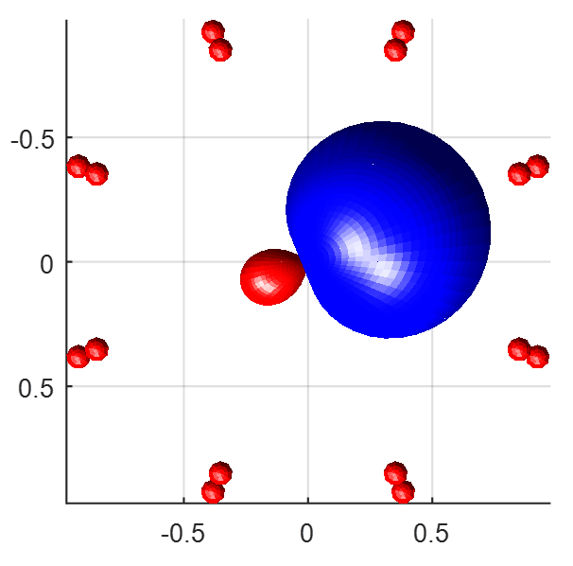
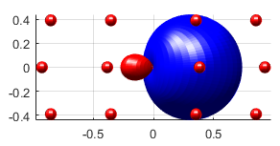
Slightly irregular design
Take MS216
24 speakers (actually more now)
3 levels of 8 at +/- 23 degrees (not a high room!)

Slide 40
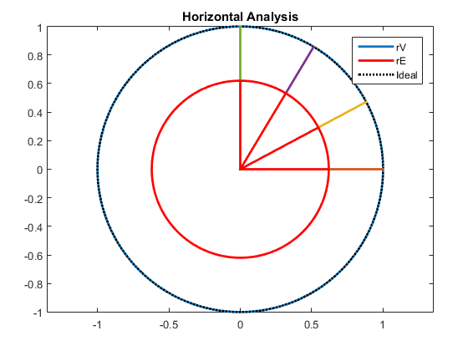
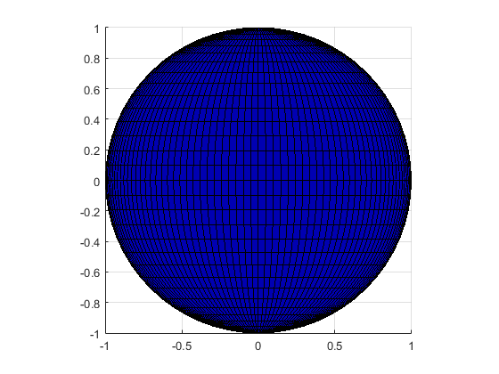
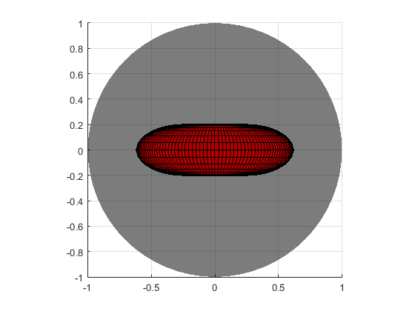
1st Order Pseudo Inverse
LF Optimised (Velocity)
2D & 3D Velocity and Energy Vector Analysis

Slide 41
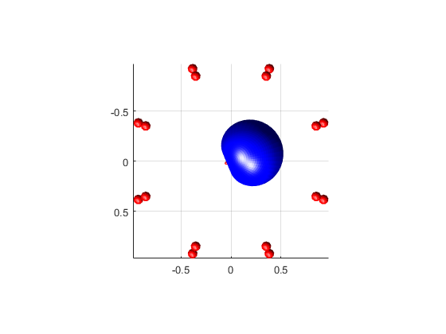
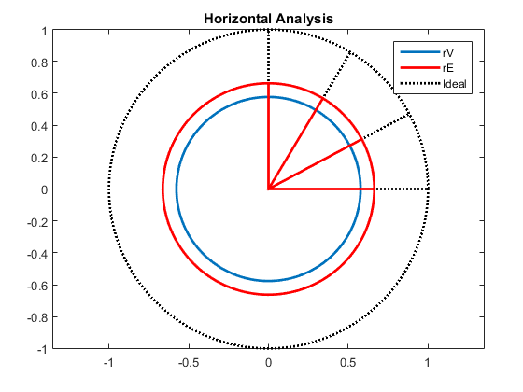
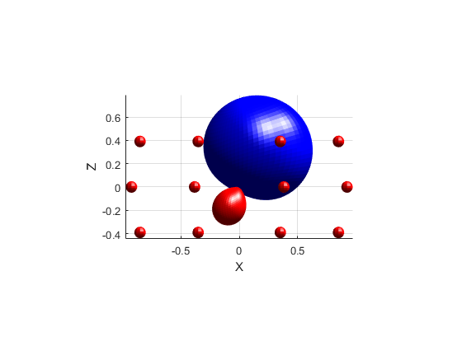
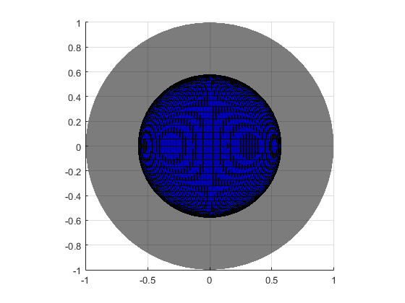
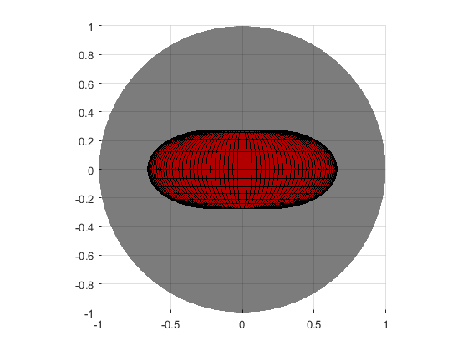
1st Order Pseudo Inverse
HF Optimised (Energy)
2D & 3D Velocity and Energy Vector Analysis

Slide 42
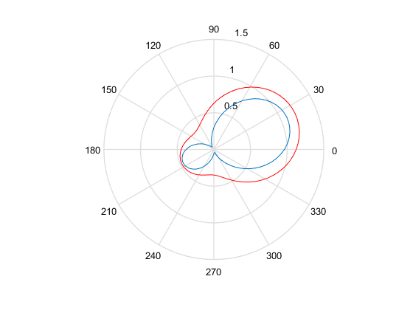
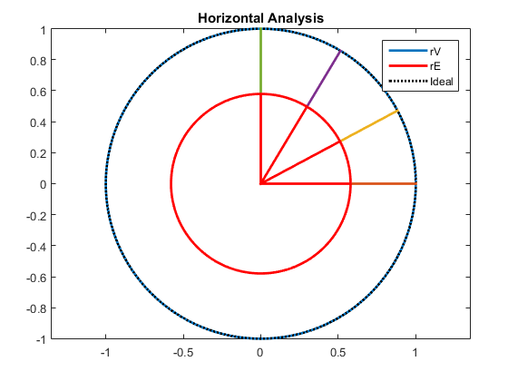
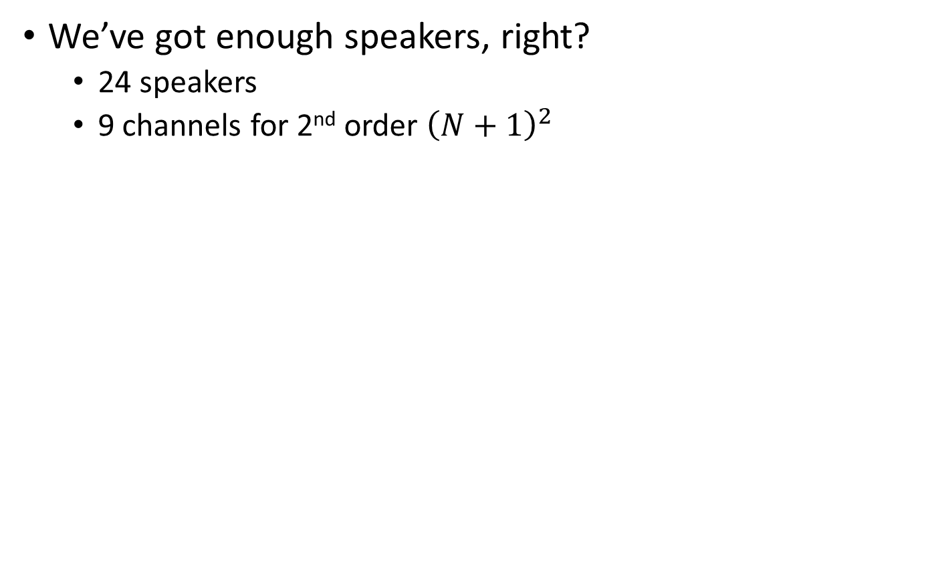
2nd Order
We’ve got enough speakers, right?
24 speakers
9 channels for 2nd order ${\left(N+1\right)}^{2}$

Slide 43
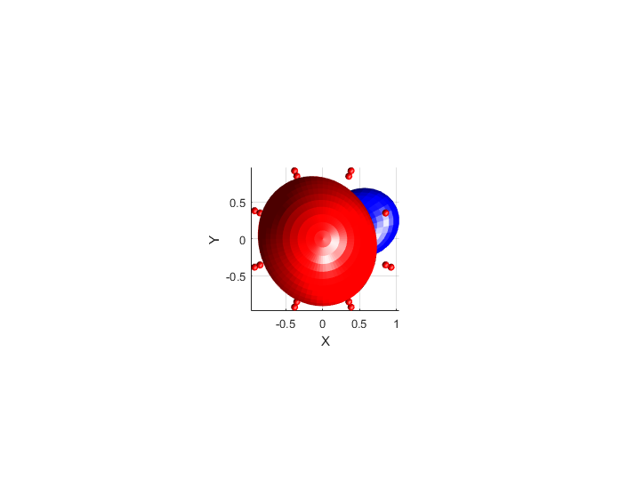
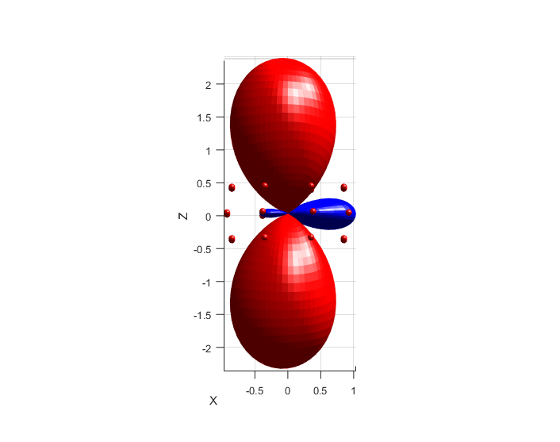

2nd Order
Let’s look at the virtual polar patterns.
Speaker 1 (middle 8)
Oh dear!
When a source is panned up, audio at >+6dB will be fed to the horizontal array.
Unlikely to sound ok!
Velocity and Energy plots look ok, though.
What’s going on?

Slide 44
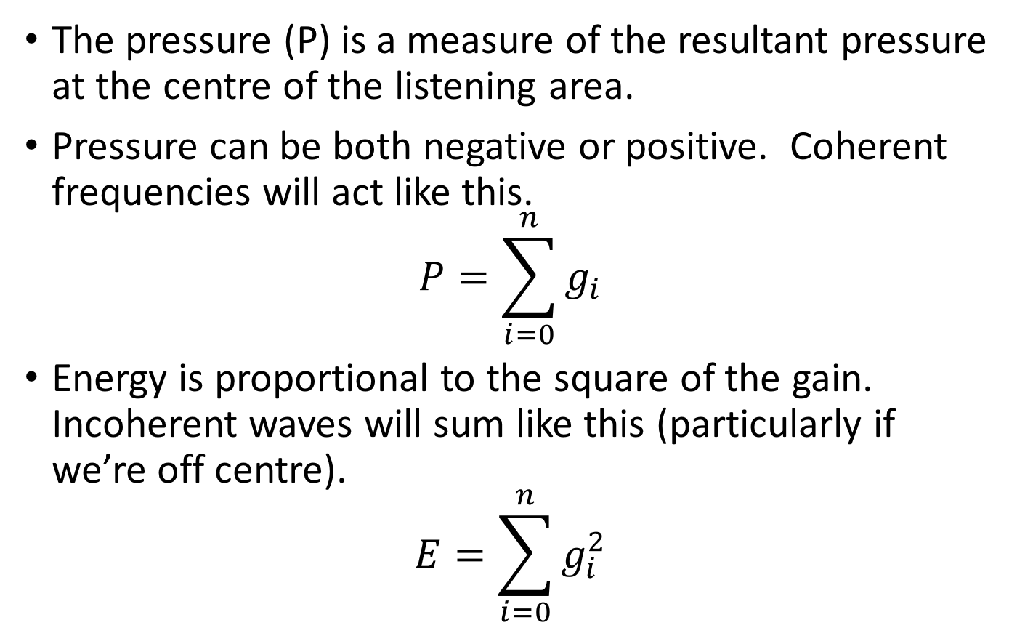
Pressure & Energy
The pressure (P) is a measure of the resultant pressure at the centre of the listening area.
Pressure can be both negative or positive. Coherent frequencies will act like this.
$$P=\sum_{i=0}^{n}{g_{i}}$$
Energy is proportional to the square of the gain. Incoherent waves will sum like this (particularly if we’re off centre).
$$E=\sum_{i=0}^{n}{g_{i}^{2}}$$

Slide 45
Four channel example
Even spread of pressure/energy
Note horizontal array!
Also note that sound comes out the speakers even when panned above and below.

Slide 46
24 Channel Example
If we had speakers at +/- 45 degrees elevation

Slide 47
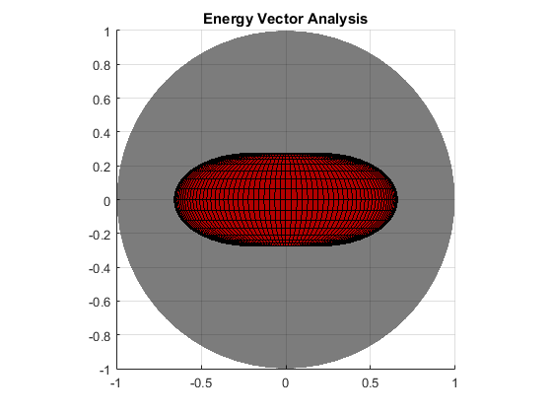
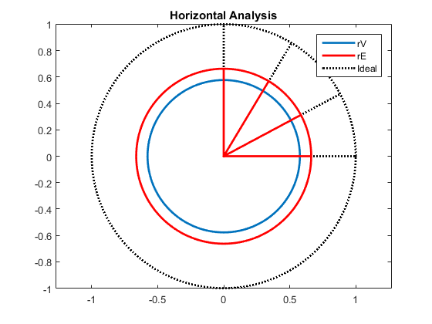
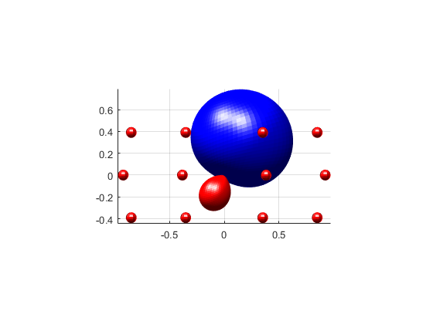
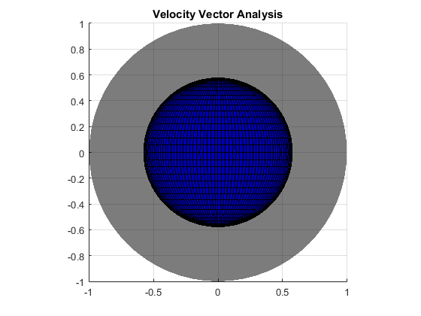
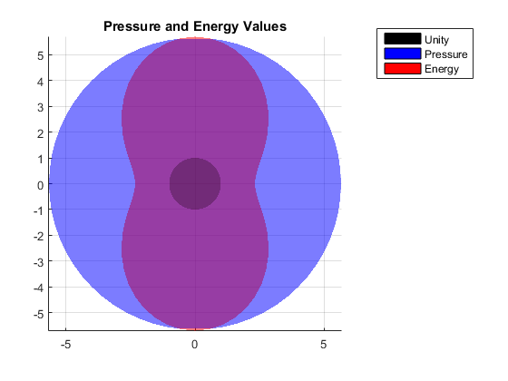
24 Speakers +/- 23°

Slide 48
2nd Order
What can we do?
See Travis03 for a good variable order scheme.
Here, we basically stop including components until a satisfactory result occurs.
Goes from horizontal only -> full periphonic.

Slide 49

Variable Order
In this chart l represents order (degree) and m is index:
Take our 2nd order system.
Full 2nd order is 9 channels
2H1V would miss out m=0 harmonic (R)

Slide 50





24 Speaker suppressed R channel
Top Front Left Speaker →
Middle Front Left Speaker

Slide 51




Energy/Velocity Analysis
Velocity Optimised (straight pseudo inverse)

Slide 52




Energy/Velocity Analysis
Energy Optimised
Top Front Left Speaker →
Middle Front Left Speaker

Slide 53




Energy/Vector Analysis

Slide 54






3rd Order
Full 3rd Order

Slide 55



3rd Order 3H1V
Need to ditch R, K, L & M (Furse Malham)

Slide 56





3rd Order 3H1V

Slide 57



3rd Order 3H1V
Velocity Optimised

Slide 58




3rd Order 3H1V
Energy Optimised

Slide 59
Summary
We’ve looked at, and covered the following today:
What is Ambisonics?
Ambisonic Decoding by Projection
Ambisonic Decoding using the Psuedo Inverse
Higher Order Ambisonics
Variable Order Ambisonics
Analysis of regular and irregular decoders using the energy and velocity vectors.

